Slide 1

FireRisk Brampton
Predictive Mapping for a Safer City

Slide 2

The Problem: An Urgent Risk
Fires in Brampton pose a significant threat to life and property. 2012-2016 was a tragic year with around 595 fire-related incidents.
This risk is amplified by:
🔥
Unattended cooking.
32% of total reported fires and 45% of associated deaths
🔥
Hidden dangers from unregistered secondary units.
10% from unregistered basements.
🔥
The need to move from reactive to proactive prevention.

Slide 3
Our Solution: The FireRisk Map
A dynamic, multi-layered predictive map for Brampton.
Predictive Heat Map: Identifies high-probability fire zones before a fire starts using a weighted risk formula.
Historical Data Overlay: Validates the model by cross-referencing high-risk zones with actual past fire incidents.
Data-Driven Insights: Built using real-world satellite data to pinpoint where prevention is needed most.

Slide 4






Using Space to Solve Problems
Powered by Satellite Data
Google Earth Engine
Python Processing
This project is powered by data from space, by analyzing satellite imagery to create real-world impact.
EE and geeMap
We use the Google Earth Engine API to access and process petabytes of geospatial data streams efficiently.
Python scripts are used to query the API, apply our custom risk formula, and render the final map layers.
Libraries used: NumPy and MatPlotLib

Slide 5
The Risk Formula
Our model calculates a weighted risk score for every point on the map. This formula combines the key drivers of fire risk.

Slide 6
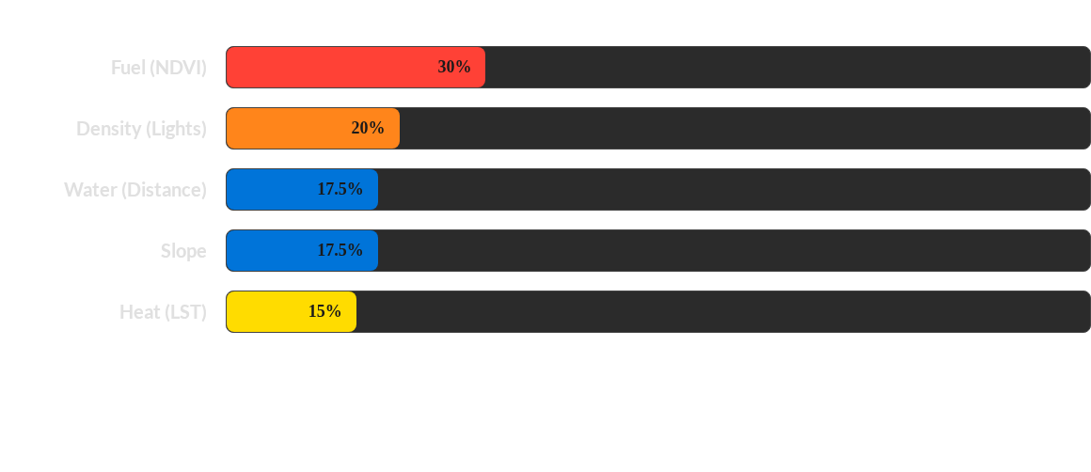
What Matters Most: Risk Factor Weighting
Fuel (dry vegetation) is the most heavily weighted factor, as it's a primary driver of fire spread. Density acts as a proxy for human activity.

Slide 7
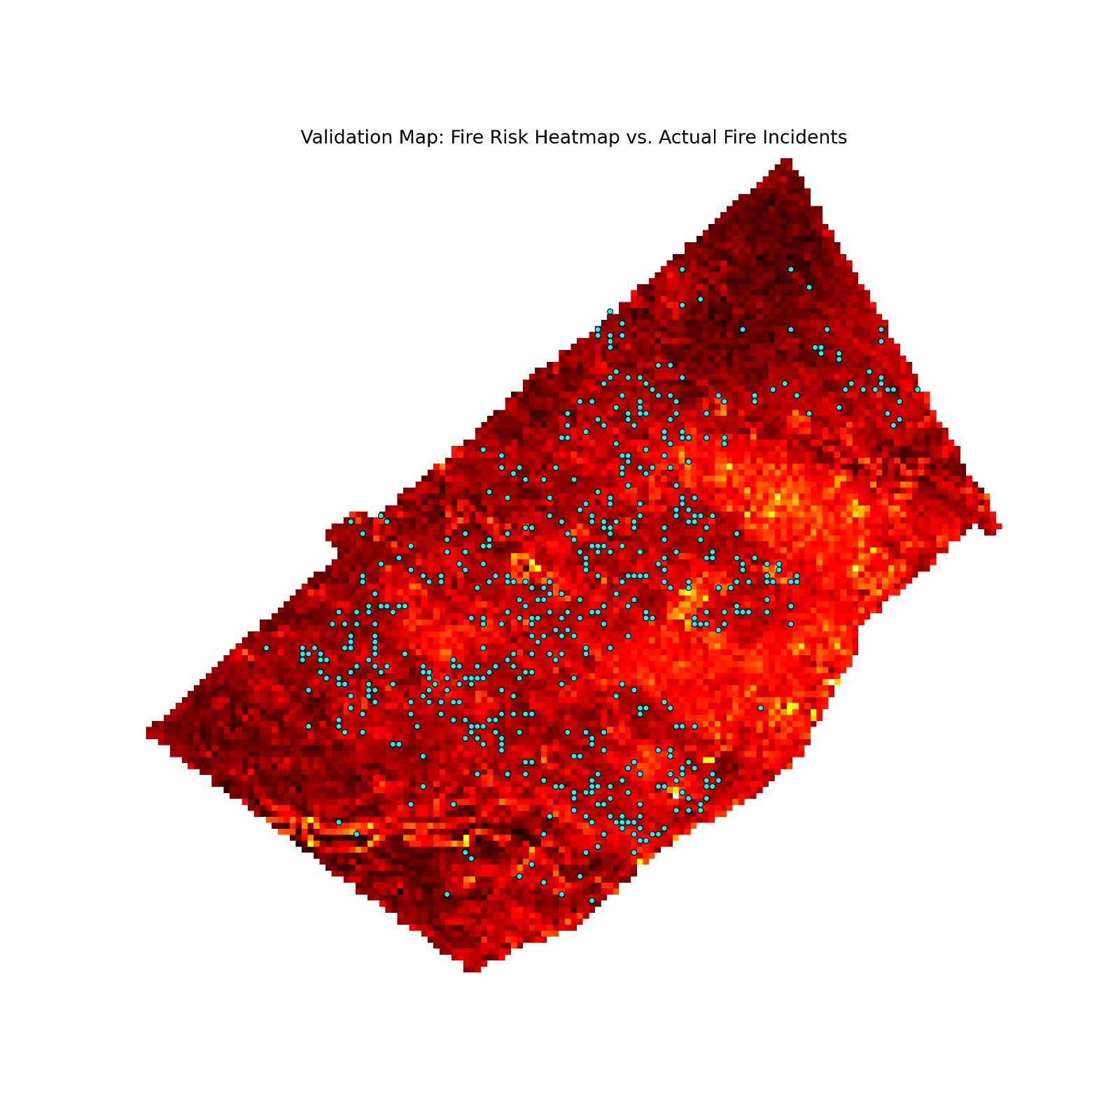

Visualizing The Risk
1. The Risk Heat Map
A predictive layer where lighter colors indicate a higher calculated probability of a fire starting.
2. The Incident Overlay
A transparent layer of blue dots marks actual, historical fire locations from 2012 to 2016.
3. The Insight
Where red zones and past fires overlap, our model is validated. Where red zones exist without past fires, it highlights a critical area for future prevention.

Slide 8






Making a Lasting Impact
Brampton Fire Service
Urban Planners
The Public
Allocate resources, plan proactive inspections, and target high-risk "Hot Zone" neighbourhoods.
Make data-informed decisions about new developments, fire breaks, and green space management.
Enable targeted public awareness campaigns (like 'Home Safe Home') in the areas that need them most.

Slide 9
The Future of FireRisk
Phase 2: Machine Learning
Implement ML to analyze incident data and automatically refine the risk-weighting formula.
Phase 1: Real-Time Data
Phase 3: Public Alerts
Integrate live weather feeds and drought indices for a truly dynamic risk score.
Develop a public-facing, simplified map and alert system to notify residents in high-risk zones.

Slide 10
References
https://geohub.brampton.ca/datasets/official-plan-schedule-a-general-land-use/about
https://geohub.brampton.ca/datasets/brampton::ward-boundaries/about
https://geohub.brampton.ca/datasets/c0becda03ea944cca84bcff7d42f61b2_0/explore?location=43.736632%2C-79.736438%2C12.04

